Slide 1
Using Git for Today’s Assessment

Slide 2
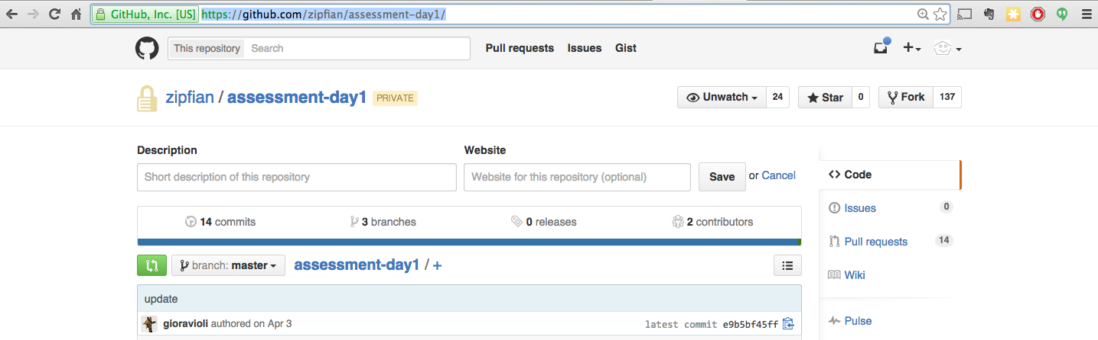
Find the Assessment on GitHub
https://github.com/zipfian/assessment-day1

Slide 3
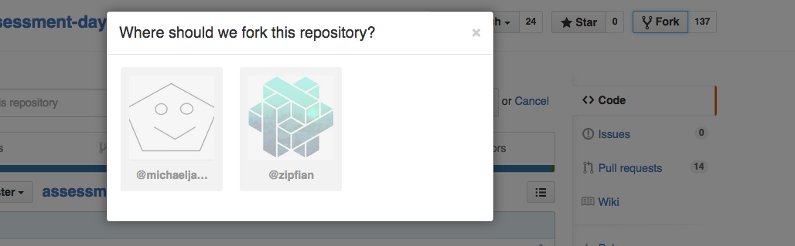
Fork the Assessment Repo
click the Fork button on the top right
choose your GitHub account

Slide 4
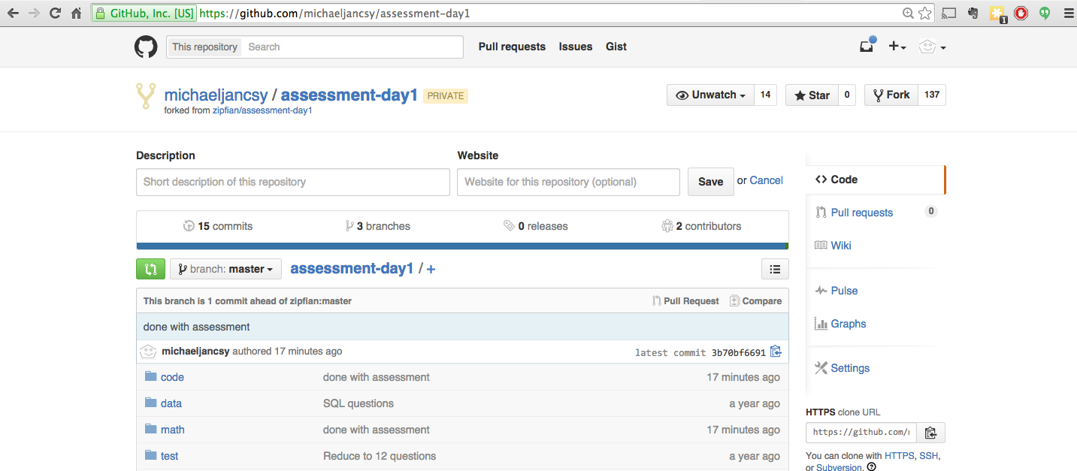
Find the Assessment in Your Account

Slide 5
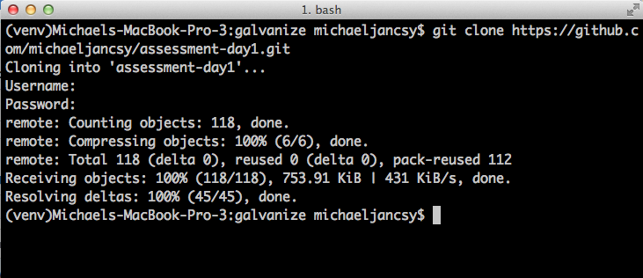
Clone the Assessment Repo Locally
git clone https://github.com/(your name)/assessment-day1.git

Slide 6
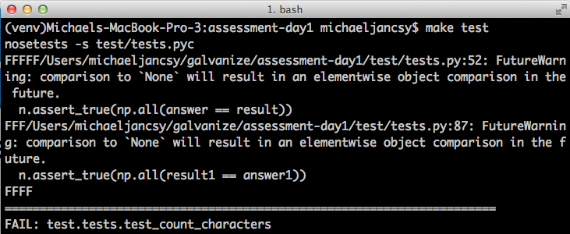
Run Tests in Assessment Directory
Run: make test
If the tests don’t run, flag down an instructor or DSR.

Slide 7
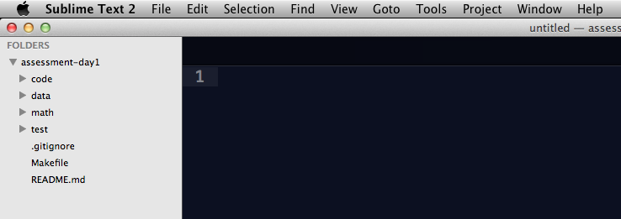
Open Assessment Folder in Sublime

Slide 8
Fill in Your Answers in Sublime
assessment.py and math.txt

Slide 9
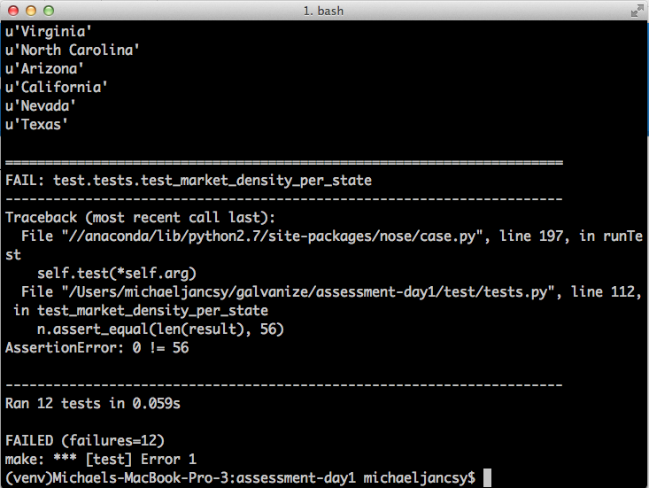
Test Your Code
make test

Slide 10
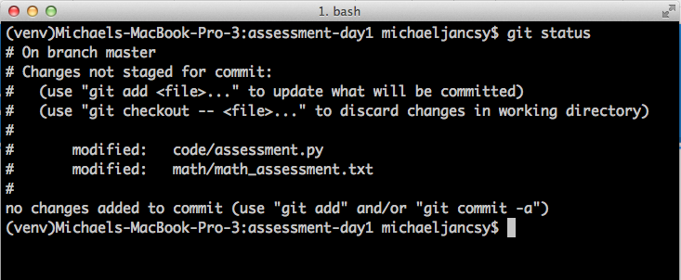
Check that your files have changed
git status

Slide 11
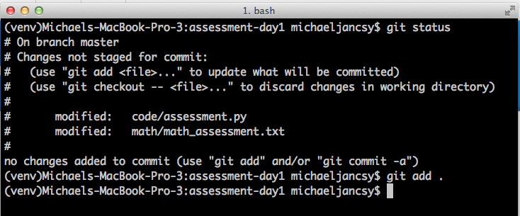
Add Your Changes
git add .

Slide 12
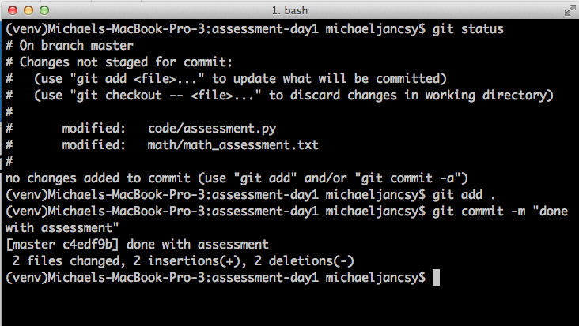
Commit Your Changes
git commit -m “done with assessment”

Slide 13
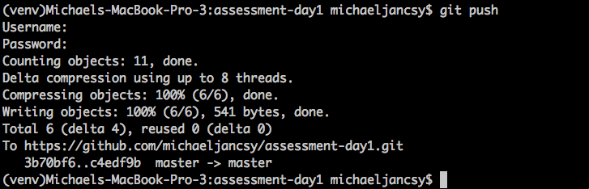
Push Your Changes to Your Account
git push

Slide 14
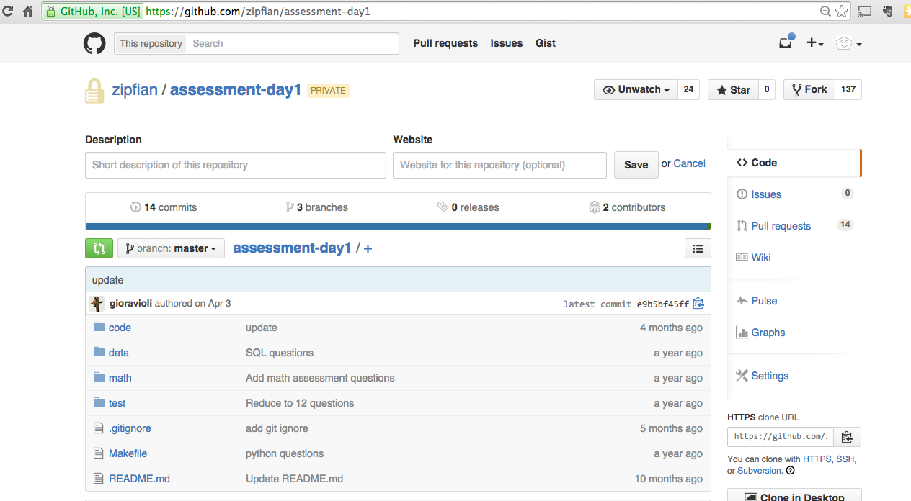
Create a Pull Request
Pull requests are how assessments and assignments are submitted
To begin, go to github.com/(your username)/assessment-day1
Click on “Pull requests”

Slide 15
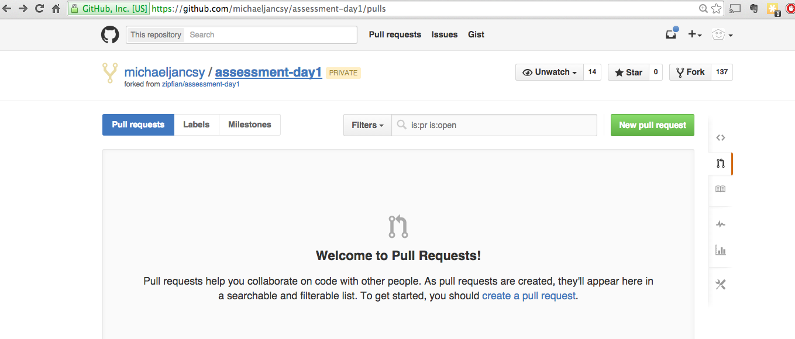
Create a Pull Request

Slide 16
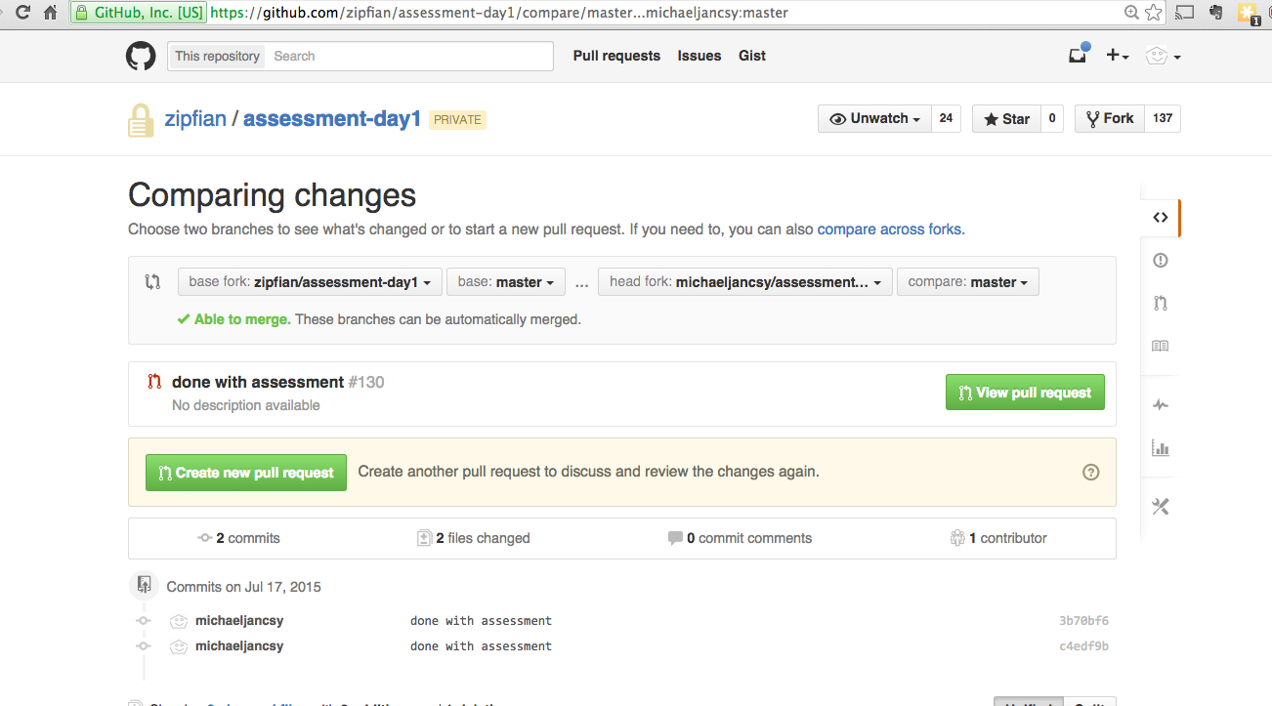
Create a Pull Request
Select your fork as the “head fork”

Slide 17
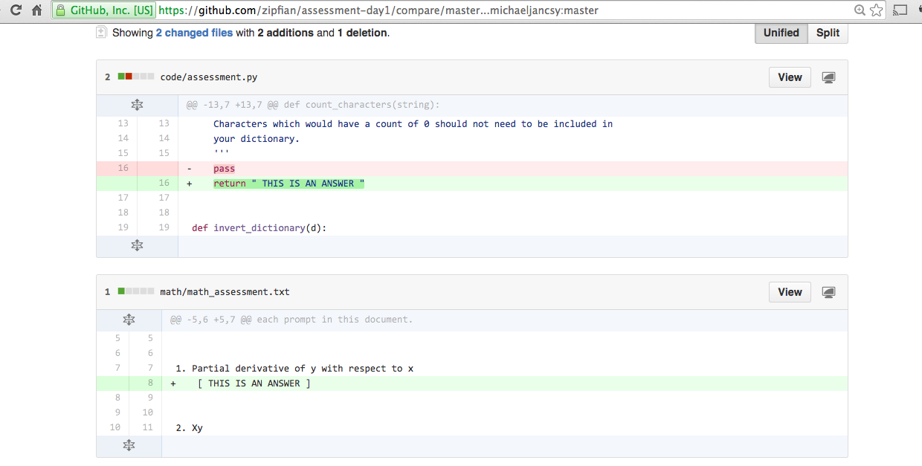
Create a Pull Request
Scroll down to see the changed files

Slide 18
Create a Pull Request
Click “Create a new pull request”

Slide 19
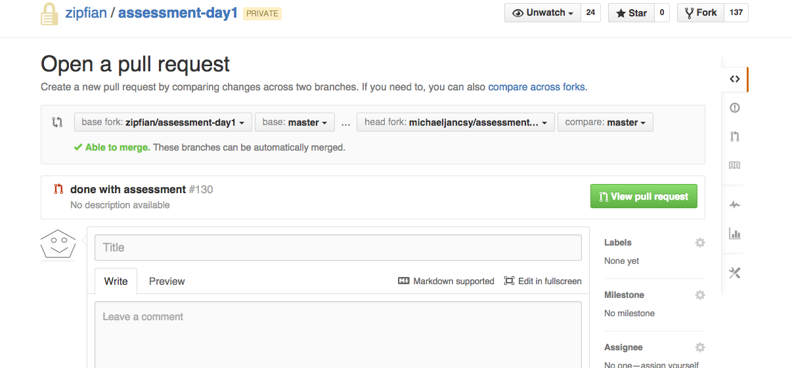
Create a Pull Request
Type your full name as the title

Slide 20
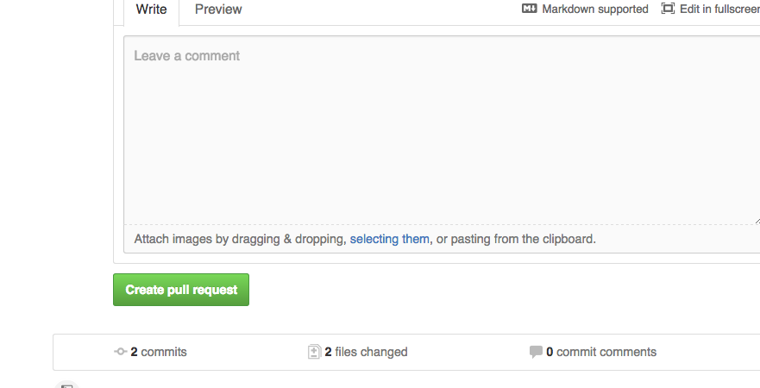
Create a Pull Request
Click “Create pull request”

